Slide 1

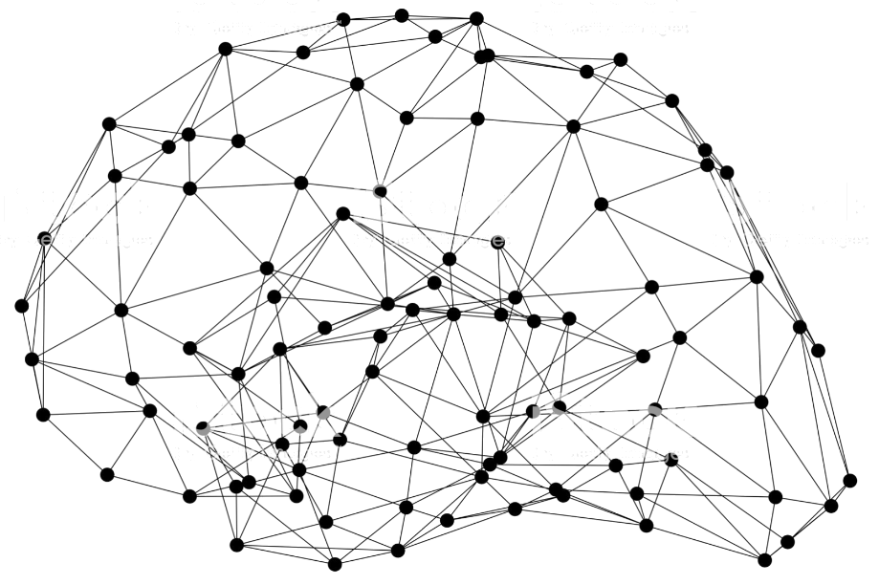

Amazon SageMaker
AutoML Demo
Nicholaus Lawson
Solution Architect
AutoML Demo
Notes:
Thanks for coming
We are covering
-SageMaker generally
-SageMaker studio
-AUTO ML options
Have a lab at the end

Slide 2
The AWS ML stack Broadest and most complete set of machine learning capabilities
Vision
Chatbots
Business tools
Search
Healthcare
Rekognition
Lex
Personalize Forecast Fraud Detector
Lookout for Metrics
Kendra
HealthLake
Comprehend Medical
Transcribe Medical
AI SERVICES
Speech
Text
Contact centers
Code + DevOps
Industrial
Polly Transcribe
Comprehend Translate Textract
Contact Lens Connect Voice ID
CodeGuru DevOps Guru
Panorama Appliance and SDK, Monitron, Lookout for Equipment, Lookout for Vision
SAGEMAKER STUDIO IDE
Label data
Data collection prep
Store features
Detect bias and explain predictions
Visualize in notebooks
Pick algorithm
Train models faster
Tune parameters
Deploy in production
Manage & monitor
Manage edge devices
AMAZON SAGEMAKER
CI/CD
ML FRAMEWORKS & INFRASTRUCTURE
TensorFlow, PyTorch, Apache MXNet
Deep learning AMIs & containers
GPUs
Inferentia
Elastic inference
FPGA
Notes:
Just to quickly level set about what I’ll be talking about tonight
Bottom is the foundation that allows AWS to build all the offerings about it.
Middle is the SageMaker ecosystem.
That is a big umbrella, it covers a lot of tools to help data sci and AIML engineers
Top is fully managed, ready to go out of the box solutions for things like
Img recog
Transcription
NLP – like comprehend to get analysis of text including things like sentiment analysis and key phrases
Today is about SageMaker and some pretty nice Auto ML options to help get you started quicker

Slide 3
Quick intro to Amazon SageMaker

Slide 4
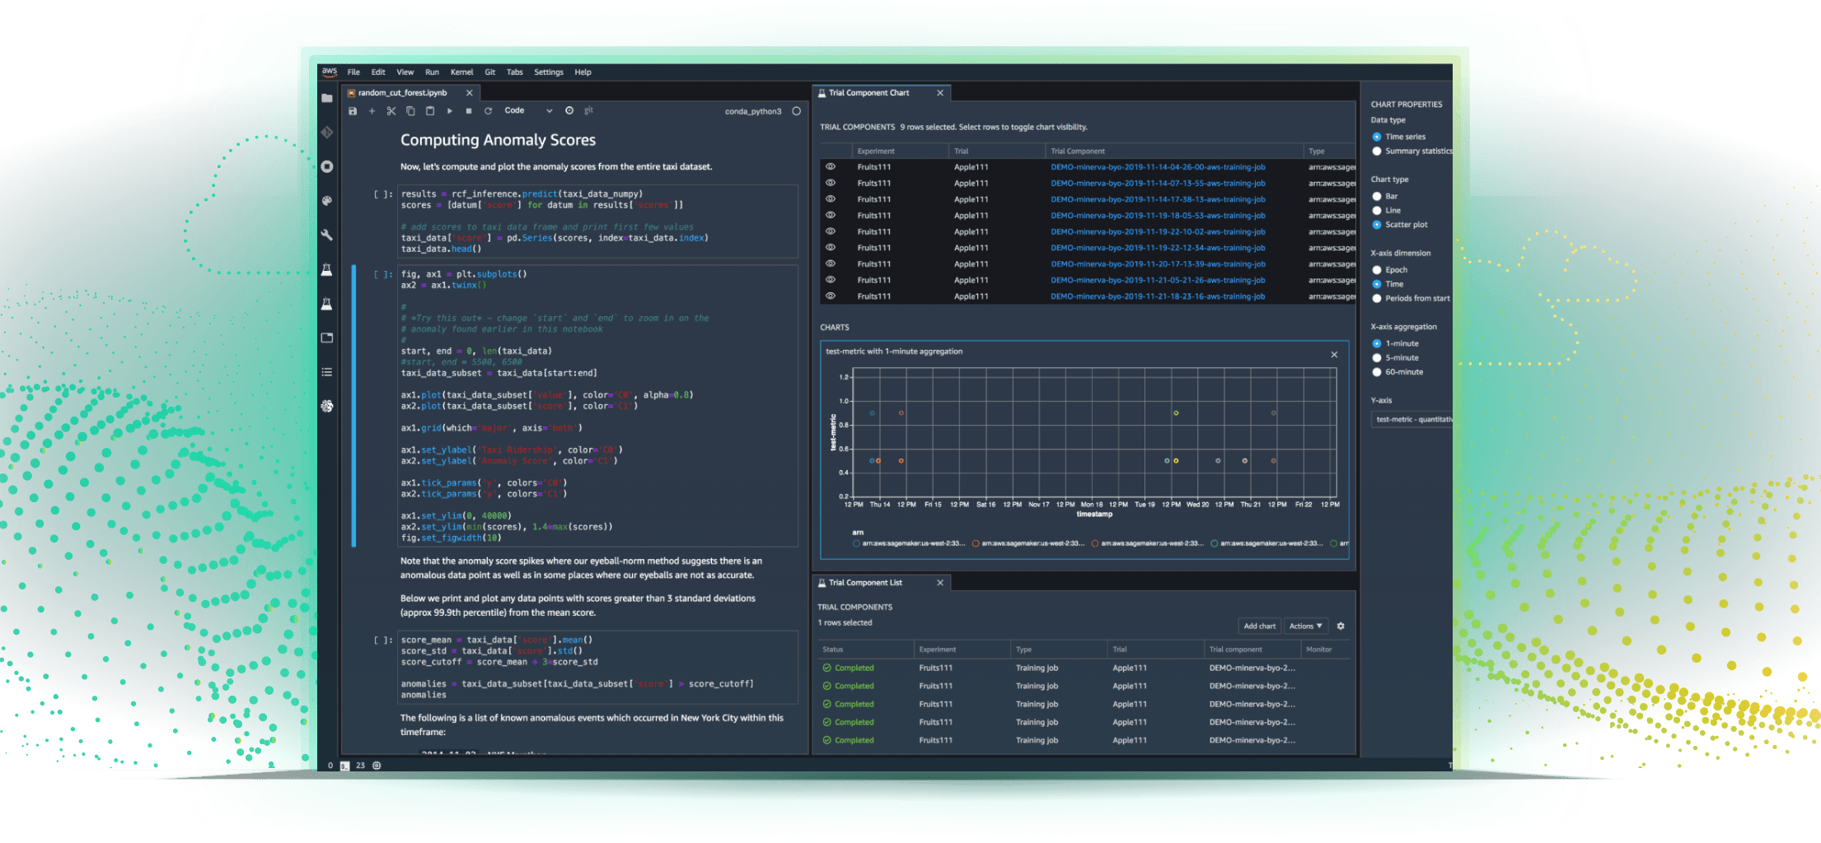
Amazon SageMaker
Most complete, end-to-end ML service
Integrated Workbench
IDE designed specifically for ML, data preparation, experiment management, and workflows
Managed Infrastructure
Designed for ultra low latency and high throughput, automatic scaling, and distributed training
Managed Tooling
Purpose-built from the ground up to work together including auto ML, collaboration, debugger, profiler, bias analyzer, and explainability
https://aws.amazon.com/sagemaker
Notes:
We are going to be focusing mainly on SageMaker Studio
Integrated IDE/workbench that wraps up all the SM offerings
Manages the infra needed to run your notebooks, endpoints, and training jobs

Slide 5
AI/ML life cycle
Amazon SageMaker
PREPARE
SageMaker Ground Truth Label training data for machine learning
SageMaker Data Wrangler Aggregate and prepare data for machine learning
SageMaker Processing Built-in Python, BYO R/Spark
SageMaker Feature Store Store, update, retrieve, and share features
SageMaker Clarify Detect bias and understand model predictions
BUILD
SageMaker Studio Notebooks Jupyter notebooks with elastic compute and sharing
Built-in and Bring your-own Algorithms Dozens of optimized algorithms or bring your own
Local Mode Test and prototype on your local machine
SageMaker Autopilot Automatically create machine learning models with full visibility
SageMaker JumpStart Pre-built solutions for common use cases
TRAIN & TUNE
Managed Training Distributed infrastructure management
SageMaker Experiments Capture, organize, and compare every step
Automatic Model Tuning Hyperparameter optimization
Distributed Training Training for large datasets and models
SageMaker Debugger Debug and profile training runs
Managed Spot Training Reduce training cost by 90%
DEPLOY & MANAGE
Managed Deployment Fully managed, ultra low latency, high throughput
Kubernetes & Kubeflow Integration Simplify Kubernetes-based machine learning
Multi-Model Endpoints Reduce cost by hosting multiple models per instance
SageMaker Model Monitor Maintain accuracy of deployed models
SageMaker Edge Manager Manage and monitor models on edge devices
SageMaker Pipelines Workflow orchestration and automation
SageMaker Studio Integrated development environment (IDE) for ML
Notes:
So for the demo, I am going to download some house price data and I will have 4 different notebooks that work off that data
So we will get to see Studio Notebooks, built-in algorithms, Autopilot, and Experiments.
I wanted to include this slide though, just to give an idea of what tools actually sit under that SM umbrella
Incredibly helpful tools like DW to help you dive into your data and turn into actual features that can be used to build models
Clarify, that can help to detect bias not just in your raw data and features but also in the end model
Over in train/tune
Automatic model tuning, this and data prep tend to be the most time consuming for me
It doesn’t take long to change hyperparameters but it does take a long time to train all the different models, then examine their scores
Debugger that can hook into your algorithms to give you real time feedback into what is happening during training
You don’t have to wait hours or days for a training job to complete just to realize something went wrong a few minutes into training or after an hour your scores aren’t improving

Slide 6
Quick intro to Amazon SageMaker
Studio

Slide 7
Collaboration at scale
Without tracking code dependencies
Easy experiment management
Organize, track, and compare thousands of experiments
Amazon SageMaker Studio
Fully integrated development environment (IDE) for Machine Learning
Automatic model generation
Full visibility and control without writing code
Higher quality ML models
Automatically debug errors, monitor models, and maintain high quality
Increased productivity
Code, build, train, deploy, and monitor in a unified visual interface
Notes:
So studio itself
Helps you track experiments, what changed, what parameters were used, and what were the end results of a run
Both DW and AutoPilot can generate models for you with very little input.
While the default, out of the box values won’t be the best result, they are often great starting points to verify your idea and ensure you have data that can support you
Everything SM all under one roof.
You don’t have to constantly switch back out to the AWS console to check training jobs, endpoint deployments, data processing jobs.
And I will give a general overview of the studio when start our lab

Slide 8
Each algorithm solves a type of prediction problem
Computer Vision
Topic Modeling
Classification
Linear Learner *
XGBoost *
KNN
Factorization Machines
Image Classification <>
LDA
NTM
Object Detection <>
Semantic Segmentation
Recommendation
Forecasting
Factorization Machines * (+ KNN)
DeepAR *
Working with Text
Blazing Text
Supervised
Unsupervised *
Clustering
Anomaly Detection
Random Cut Forests *
Kmeans *
KNN
IP Insights *
Feature Reduction
Sequence Translation
Regression
Linear Learner
XGBoost
KNN
PCA
Seq2Seq *
Object2Vec
* = distributed training
<> = incremental training
Notes:
SageMaker comes with several built in algorithms
So, for general classification we can use Linear Learner, KNN, or XGBoost
I’ll be showing off the built in XGBoost algorithm tonight against the regression problem of house prices
But this is a great little cheat sheet, if you know what class of problem you need to solve, this shows you what are some built in choices.

Slide 9
AutoML and SageMaker

Slide 10





Amazon SageMaker Autopilot
Provide data
Specify column to predict
Create model
Track experiment
Transparent
Data in tabular form
Support for regression and classification
Feature generation, algorithm selection, and parameter tuning
Automatically tracked as an experiment
Get notebook with source code
Notes:
You simply provide a tabular dataset and select the target column to predict
SageMaker Autopilot will automatically explore different solutions to find the best model.
You then can directly deploy the model to production with just one click or iterate on the recommended solutions to further improve the model quality.
One very nice feature about AutoPilot is, there is no need to worry about feature engineering.
So if you aren’t great at it, or just lack patience (like I do) then it can be very nice to quickly run your data through AutoPilot and see what kind of model it can generate.
Currently it supports XGBoost and Linear Learner algorithms.
Given that XGBoost is new hotness, you do usually get good results.

Slide 11
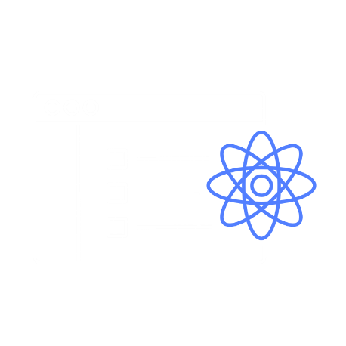
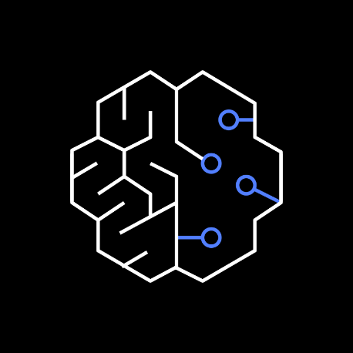



Why building ML models is hard…
1
2
3
4
Data Preparation and Feature Engineering
Model Training
Model Tuning
Model Deployment
Notes:
In my experience, you sink most of your time in steps 1 and 3.
The algorithms are what they are, unless you are trying to write your own from scratch. They are packaged and accept your data and just work.
Getting that data into features, and knowing which features are the right ones to use, takes up most of your times.
Once your features are ready, you’ve chosen your model, then its turning all the knobs to find what works best for your problem and your data.
XGBoost, for instance, has over a dozen parameters you can set and tweak. While knowing what to move and when comes with experience, some of it still comes down to, run several models and see what looks best.
Running multiple models is what can be so time consuming.

Slide 12
Why building ML models is hard…
1
2
3
4
Data Preparation and Feature Engineering
Model Training
Model Tuning
Model Deployment
Automated by SageMaker Autopilot

Slide 13
AutoML with Amazon SageMaker Autopilot
SageMaker Autopilot covers all steps
Problem identification: looking at the data set, what class of problem are we trying to solve?
Algorithm selection: which algorithm is best suited to solve the problem?
Data preprocessing: how should data be prepared for best results?
Hyperparameter tuning: what is the optimal set of training parameters?
Supported algorithms at launch:
Linear Learner, XGBoost
Notes:
AutoPilot aims to help in all of these areas.
It will prep your data, do feature engineering, and even show you which features it thinks are the most useful.
Then it will train on different algorithms and use automated hyperparameter tuning to try to find the best set up.
It’s definitely worth noting here, even if you don’t/cant use AP, you still have some of these available to you in DW and auto HPO within SM

Slide 14
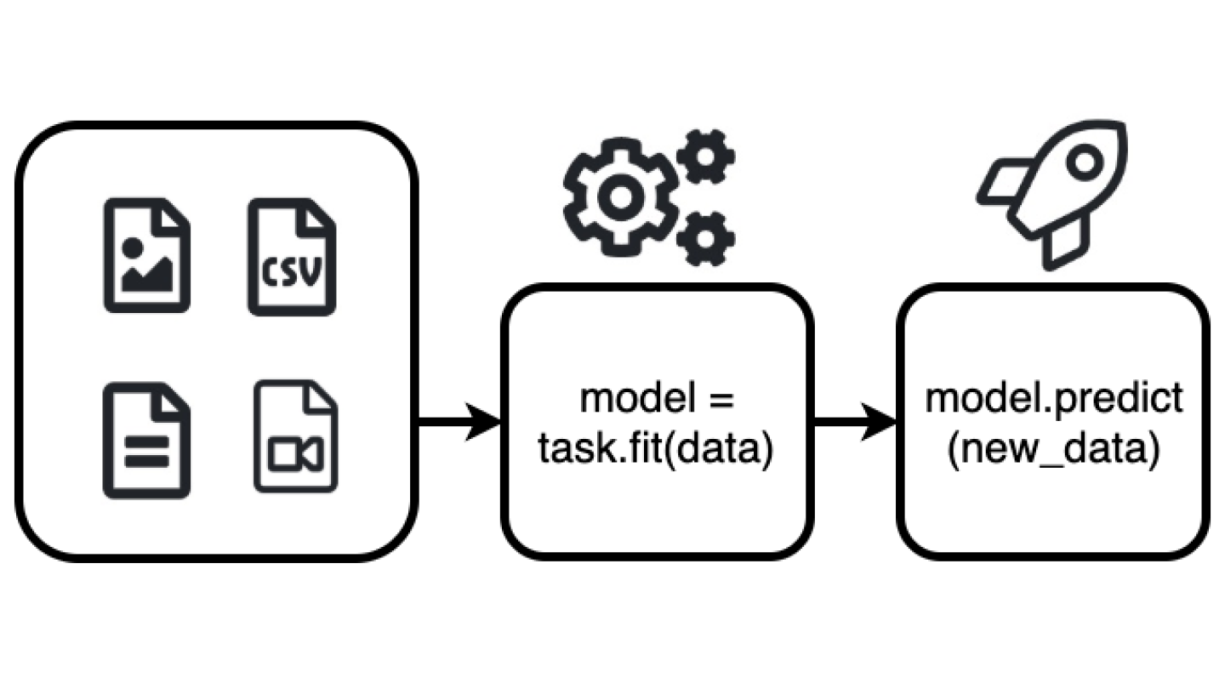
AutoGluon
AutoGluon enables easy-to-use and easy-to-extend AutoML with a focus on
automated stack ensembling, deep learning, and real-world applications spanning
image, text, and tabular data.
Quickly prototype deep learning and classical ML solutions for your raw data with a few lines of code.
Automatically utilize state-of-the-art techniques (where appropriate) without expert knowledge.
Leverage automatic hyperparameter tuning, model selection/ensembling, architecture search, and data processing.
Easily improve/tune your bespoke models and data pipelines, or customize AutoGluon for your use-case.
Notes:
AutoPilot is a pretty cool service, I enjoy using it when I’m playing around with data or with problems off of Kaggle to get an idea of what I should do and what good looks like.
But, it is very SM centric. If you aren’t working in SM Studio, AutoPilot isn’t an option. It is also restricted in what problems it can help you solve for.
If you need a more general AUTO ML option, or can’t work in SM, AutoGluon is a very promising framework worth looking at.
AutoGluon is an open source solution, developed by AWS Labs and provided to the general AIML community. It can work on tabular or image data, can be used in deep learning scenarios
It still offers some data preprocessing/feature engineering for you as well
Anecdotally, I’ve seen AutoGluon perform quite well when used on Kaggle competitions…..so, take that for what its worth, but it’s incredibly cool tool to have in your toolbelt

Slide 15
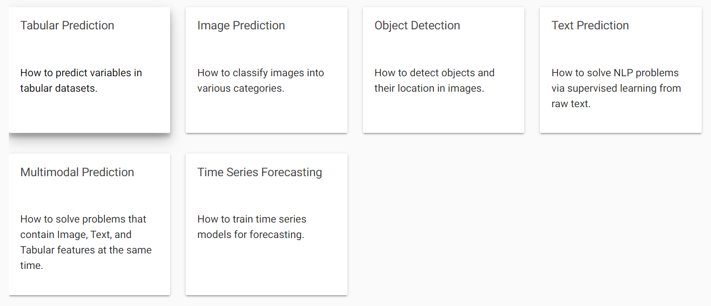
AutoGluon
Notes:
So AutoGluon offers to help in more problem spaces than AutoPilot.
You can throw tabular data as well as images at it
It is useful for object detection, NLP, as well as forecasting

Slide 16
Getting started with SageMaker
Notes:
Demo coming soon, just a couple slides before we are there
I just wanted to talk about a couple ways to get started in SM on your own.

Slide 17
SageMaker JumpStart
15+ pre-built solutions for common ML use cases
Solutions can be used out-of-the-box or can be customized for a specific business problem
Accelerate time to deploy over 150 open source models
Use one-click deployable ML models and algorithms from popular model zoos
Easily and quickly bring machine learning applications to market
Get started with just a few clicks
Easily bring ML applications to market using pre-built solutions, ML models, and algorithms from popular model zoos, and getting started content
Notes:
Part of SM is called JumpStart
There are several pre-build solutions that showcase how to tackle some common ML use cases
They come with all the code you need to get up and going quickly.

Slide 18
SageMaker JumpStart Use cases
Autonomous driving
Predictive maintenance
Churn prediction
Computer vision
Personalized recommendations
Fraud detection
Extract data from documents
Demand forecasting
Credit risk prediction
Notes:
Some of the pre-built solutions include Customer Churn, Computer visions, personalization, fraud detect, and data extraction from documents.
In my past jobs, those companies were really starting to focus on both churn and personalization, and its something that is showing up more and more on businesses radar.

Slide 19









Amazon SageMaker JumpStart pre-built solutions
Demand Forecasting
Demand forecasting with deep learning >
Fraud Detection
Detect malicious users and transactions >
Fraud detection in financial transactions using deep graph library >
Predictive Maintenance
Predictive maintenancefor manufacturing >
Predictive maintenance for vehicle fleets >
Credit Risk Prediction
Explain credit decisions >
Extract & Analyze Data from Documents
Document summarization, entity, and relationship extraction >
Handwriting recognition >
Filling in missing values in tabular records >
Differential privacy for sentiment classification >
Computer Vision
Product defect detection in images >
Autonomous Driving
Visual perception with active learning >
Personalized Recommendations
Entity resolution in identity graphs >
Purchase modeling >
Churn Prediction
Churn prediction with text >
Learn more about solutions:
https://aws.amazon.com/sagemaker/getting-started/
Notes:
This slide has a few of the exact use cases that are available for each, as well as a link to get started with them

Slide 20


DEMO!
Bear with me:
-This is live, we have no animatronics here
-Depends on the internet to connect to notebook
-Depends on guest wifi
What we are going to cover
1\ Data Wrangler
2\ Hi scoring Kaggle notebook
3\ My significantly lower scoring notebook
4\ AutoGluon notebook
5\ SageMaker AutoPilot result

Slide 21

Code Repo
https://github.com/ccrngd1/AutoAIDemo

Slide 22
Thank you

Slide 23
References
https://aws.amazon.com/free
https://aws.amazon.com/sagemaker
https://github.com/aws/sagemaker-python-sdk
https://github.com/awslabs/amazon-sagemaker-examples
https://aws.amazon.com/sagemaker/autopilot/
https://auto.gluon.ai/stable/index.html#
https://github.com/awslabs/autogluon/
https://github.com/ccrngd1/AutoAIDemo

